Slide 1
Web Programming
MongoDB - CRUD
Lecture 22
Mahhek Khan
Notes:
.

Slide 2
Mongoose
ODM (Object Data Modeling) library for MongoDB
Simplifies interaction between Node.js and MongoDB
Provides:
Schema definitions
Model-based access
Middleware, validation, hooks, etc.

Slide 3
Defining a Schema and Model (.js file)
const mongoose = require('mongoose');
const userSchema = new mongoose.Schema({
name: String,
email: String,
age: Number
});
const User = mongoose.model('User', userSchema);
Schema defines the structure
Model is used to interact with the collection

Slide 4
C - Create
const newUser = new User({
name: 'Ali',
email: 'ali@example.com',
age: 25
});
newUser.save()
.then(user => console.log('Saved:', user))
.catch(err => console.error('Error:', err));

Slide 5
R - Read
// Find All Users
User.find()
.then(users => console.log(users));
//Find by ID
User.findById('ID_HERE')
.then(user => console.log(user));
//Find One with Condition
User.findOne({ email: 'john@example.com' })
.then(user => console.log(user))
.catch(err => console.log('Error:', err));

Slide 6
R - Read
//Find Multiple with condition
User.find({ name: 'John Doe' })
.then(users => console.log(users))
.catch(err => console.log('Error:', err));
//Find Multiple with multiple condition (AND)
User.find({
age: { $gte: 18 },// Age greater than or equal to 18
name: 'John Doe' // Name should be 'John Doe'
})
.then(users => console.log(users))
.catch(err => console.log('Error:', err));

Slide 7
R - READ
//Find with Multiple Conditions (OR)
User.find({
$or: [
{ age: { $gte: 18 } },
{ name: 'John Doe' }
]
})
.then(users => console.log(users))
.catch(err => console.log('Error:', err));

Slide 8
READ
User.find({ age: { $ne: 30 } }) //$ne: Not equal to
User.find({ age: { $gt: 18 } }) //$gt: Greater than
User.find({ age: { $gte: 18 } }) //$gte: Greater than or equal to
User.find({ age: { $lt: 30 } }) $lt: Less than
User.find({ age: { $lte: 30 } }) $lte: Less than or equal to
User.find({ age: { $in: [20, 25, 30] } }) $in
User.find({ age: { $nin: [20, 25, 30] } }) $nin: Not in

Slide 9
READ with async/await
async function doStuff() {
const users = await User.find();
console.log(users);
}

Slide 10
Sort
.sort({ field: 1 }) means:
1 → Ascending order (smallest to biggest)
-1 → Descending order (biggest to smallest)
User.find({ name: "John" }).sort({ age: 1 }) // Youngest John first
User.find({ name: "John" }).sort({ createdAt: -1 }) // Most recent John
User.find().sort({ score: -1, username: -1 }); //Multiple sort

Slide 11
U - Update
To update an existing product, use the findByIdAndUpdate() method:
const userId = 'user_id_here';
User.findByIdAndUpdate(userId, { $set: { age: 30 } }, { new: true })
.then(user => console.log('Updated:', user));
{ new: true } returns updated document else old document
You can also use .updateOne() or .findOneAndUpdate()

Slide 12
U - Update
// Update a single user named 'John'
User.findOneAndUpdate({ name: 'john' }, { $set: { age: 30 } }, { new: true })
.then(user => console.log('Updated:', user))
// To update all users named 'John', you would use updateMany()
User.updateMany({ name: 'john' }, { $set: { age: 30 } })
.then(result => console.log('Updated users:', result))
.catch(err => console.error('Error:', err));

Slide 13
Update and validate
Mongoose does NOT run validations on update queries because MongoDB runs updates directly on the database — it skips the Mongoose document layer where validation happens.
User.findByIdAndUpdate(userId, { age: 30 }, { new: true, runValidators: true })
.then(user => console.log('Updated:', user));

Slide 14
Multiple updates
userID = “whatever”
User.findByIdAndUpdate(
userId,
{ $set: { age: 30, email: 'newemail@example.com' } },
{ new: true })
.then(user => console.log('Updated:', user))

Slide 15
D - Delete
User.findByIdAndDelete('ID_HERE')
.then(() => console.log('User deleted'));
Also supports .deleteOne() or .deleteMany()

Slide 16
CRUD with Relation (1-M)
We'll create a User model and a Post model. A user can have many posts, so we will establish a one-to-many relationship between User and Post where:
A user can have multiple posts.
Each post belongs to a single user.

Slide 17
User Model
const mongoose = require('mongoose');
const userSchema = new mongoose.Schema({
name: { type: String, required: true },
email: { type: String, required: true, unique: true }
});
const User = mongoose.model('User', userSchema);
module.exports = User;

Slide 18
Post Model
const mongoose = require('mongoose');
const postSchema = new mongoose.Schema({
title: { type: String, required: true },
content: { type: String, required: true },
user: { type: mongoose.Schema.Types.ObjectId, ref: 'User' } // This establishes the one-to-many relationship
});
const Post = mongoose.model('Post', postSchema);
module.exports = Post;

Slide 19
CREATE
const mongoose = require('mongoose');
const User = require('./models/User');
const Post = require('./models/Post');
const createUserAndPost = async () => {
const user = new User({
name: 'Alice',
email: 'alice@example.com'
});
await user.save(); // Save the user
// Create a post for this user
const post = new Post({
title: 'First Post',
content: 'This is my first post.',
user: user._id // Reference the user. why _id?
});

Slide 20
id vs _id
_id:
Type: ObjectId
This is the actual identifier ObjectId("603d5f4e6e1d2b1e44a9bbd9").
You typically see _id when you query documents directly in MongoDB or Mongoose. It’s a unique identifier for each document.
2. id:
Type: String
String representation of the _id field.
ObjectId("603d5f4e6e1d2b1e44a9bbd9"), the id would return "603d5f4e6e1d2b1e44a9bbd9", which is easier to work with in some cases.
The id property is especially useful when you need to send the ID as a string in API responses or in JavaScript code.

Slide 21
Read Posts of a Specific User
const findUserPosts = async (userId) => {
const userPosts = await Post.find({ user: userId }).populate('user');
console.log('User Posts:', userPosts);
};
// Find all posts for the user with a specific ID
// replace with actual user ID
findUserPosts('USER_ID_HERE');
By using populate(), we can easily get the user information when fetching posts.

Slide 22
Populate()
The populate() method in Mongoose is used to populate references to documents from other collections. It allows you to perform joins (similar to SQL joins) in MongoDB by fetching documents from other collections based on referenced ObjectId fields.

Slide 23
Specifying Which Fields to Populate
You can also specify which fields to populate in the referenced document.
const findPostsWithUserNameAndEmail = async () => {
const posts = await Post.find()
.populate('user', 'name email'); // Only populate name and email of the user
};
Here, the user field will be populated with just the name and email fields of the User model.
findPostsWithUserNameAndEmail();

Slide 24
Populating Multiple References
You can populate multiple references within a single query.
const findPostWithUserAndComments = async () => {
const posts = await Post.find()
.populate('user', 'name') // Populate user
.populate('comments'); // Populate comments
};
In this case, the Post model has two references: user and comments. We use populate() to fetch user details and comment details.

Slide 25
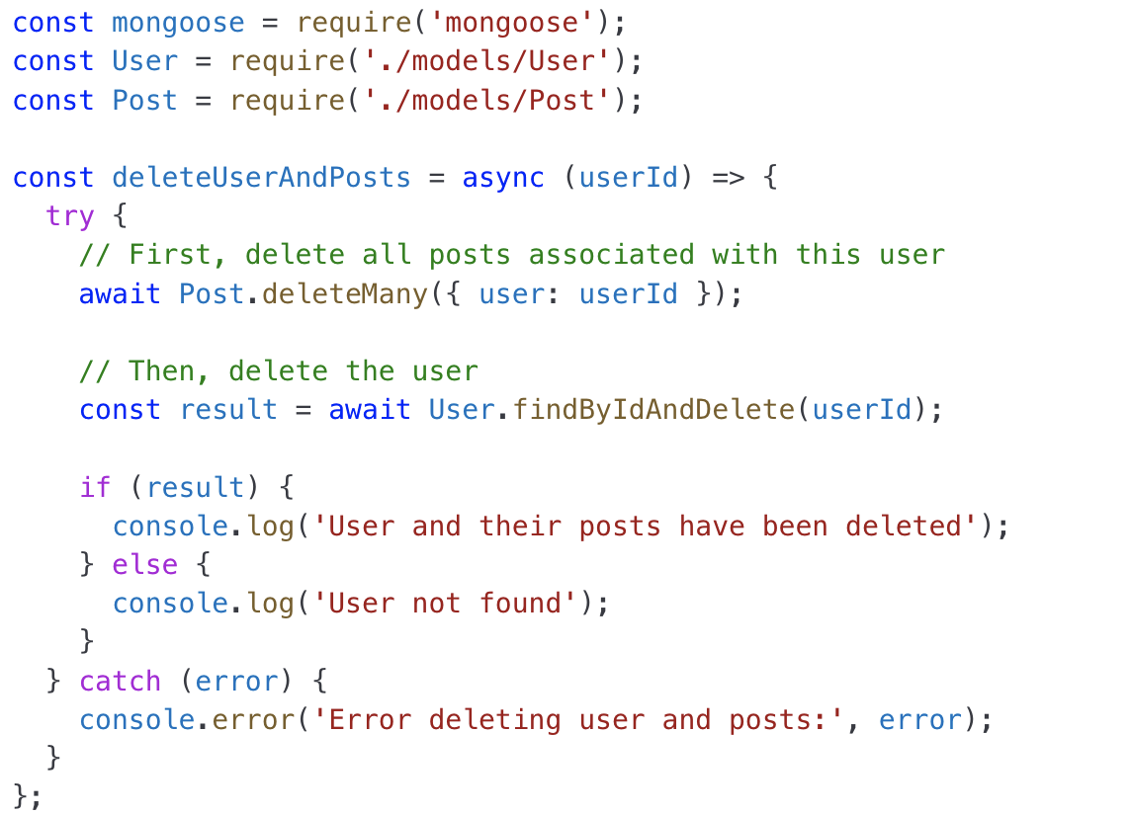
Delete

